Slide 1
6. Binding Theory The Notions Coindex and Antecedent, Binding Theory, Locality Conditions on the Binding of Anaphors, The Distribution of Pronouns, The Distribution of R-expressions.
ENG467: Syntax and Structures of Language

Slide 2
Introduction
First let us talk about some facts about the meaning of NPs in English.
There are some NPs that get their meaning from the context and discourse around them.
For example, in the sentence in (1), the meaning of the word Peter comes from the situation in which the sentence is uttered:
1) Peter wrote a very good research paper on Syntax.
This kind of NP is called a referring expression (or R-expression):
2) R-expression: An NP that gets its meaning by referring to an entity in the world.
The vast majority of NPs are R-expressions. But it is by no means the case that all NPs are R-expressions.

Slide 3
Consider the case of the NP herself in the following sentence:
3) Heidi bopped herself on the head with a zucchini. [bop means playful gentle tap]
In this sentence, Heidi is an R-expression and gets its meaning from the context,
but herself must refer back to Heidi.
Here, herself cannot refer to Mary or Rani.
It (herself) must get its meaning from a previous word in the sentence (in this case Heidi).
This kind of NP, one that obligatorily gets its meaning from another NP in the sentence, is called an anaphor.
4) Anaphor: An NP that obligatorily gets its meaning from another NP in the sentence.
Typical anaphors are himself, herself, themselves, myself, yourself, ourselves, yourselves, and each other.

Slide 4
Types of Anaphors
There are actually (at least) two different kinds of anaphors.
One type is the reflexive pronouns like herself, himself, and themselves.
The other kind are called reciprocals, and include words like each other and one another.
For our purposes, we’ll just treat this group like a single class, although there are minor differences between the distributions of reflexives and reciprocals.

Slide 5
There is yet another kind of NP.
These are NPs that can optionally get their meaning from another NP in the sentence but may also optionally get it from somewhere else (including context or previous sentences in the discourse).
These NPs are called pronouns.
Look at the sentence in (5):
5) Mary said that she played basketball.
In this sentence, the word she can optionally refer to Mary (i.e., the sentence can mean “Mary said that Mary played basketball")
or it can refer to someone else (i.e., “Mary said that Catherine played basketball").
Typical pronouns include: he, she, it, I, you, me, we, they, us, him, her, them, his, her, your, my, our, their, and one. A definition of pronoun is given in (6):

Slide 6
Getting back to syntax,
it turns out that these different semantic types of NPs can only appear in certain syntactic positions, which are defined using the structural relations we developed in the last module.
Anaphors, R-expressions, and pronouns can only appear in specific parts of the sentence.
For example, an anaphor may not appear in the subject position of sentence:
7) *Herself bopped Heidi on the head with a zucchini.
The theory of the syntactic restrictions on where these different NP types can appear in a sentence is called binding theory.
Binding theory makes reference to the structural relations we learned about in the previous module.
This module thus will be your first exposure to why structural relations are so important to syntacticians.

Slide 7
Exercise:
Q. Identify the type of NP (anaphor, pronoun, R-expression) of each of the following:
their, each cat, folk dancing, oneself, each other, she, her, themselves.

Slide 8
1. THE NOTIONS COINDEX AND ANTECEDENT
We’re going to start with the distribution of anaphors.
First, we need some terminology to set out the facts.
An NP that gives its meaning to another noun in the sentence is called the antecedent:
8) Antecedent: An NP that gives its meaning to another NP.
For example, in sentence (3) (repeated here as 9),
the NP Heidi is the source of the meaning for the anaphor herself, so Heidi is called the antecedent:
9) Heidi bopped herself on the head with a zucchini.
antecedent anaphor

Slide 9
We use a special mechanism to indicate that two NPs refer to the same entity.
After each NP we write a subscript letter.
If the NPs refer to the same entity, then they get the same letter.
If they refer to different entities they get different letters.
Usually we start (as a matter of tradition) with the letter i and work our way down the alphabet.
These subscript letters are called indices or indexes (singular: index).

Slide 10
10) a) [Andrea]_{i} gave [Colin]_{j} [a basketball]_{k}.
b) [Alvina]_{i} said that [she]_{j} played [basketball]_{k} in [the dark]_{l}.
c) [Alvina]_{i} said that [she]_{i} played [basketball]_{k} in [the dark]_{l}.
d) [Heidi]_{i} playfully bopped [herself]_{i} on [the head]_{j} with [a zucchini]_{k}.
In (10a), all the NPs refer to different entities in the world, so they all get different indexes.
The same is true for (10b).
Without the indices, this sentence is ambiguous; she can refer to Alvina or to someone else.
But with indexing, we disambiguate this form.
(10b) only has the meaning where she is not Alvina, but someone else- the pronoun she and Alvina have different indexes.
The indexing in sentence (10c), by contrast, has she and Alvina referring to the same person.
In this sentence, Alvina is the antecedent of the pronoun she, so they have the same index.
Finally in (10d), the anaphor herself refers back to Heidi so they get the same index.
Two NPs that get the same index are said to be coindexed.
NPs that are coindexed with each other are said to corefer (i.e., refer to the same entity in the world).

Slide 11
11) Coindexed: Two NPs are said to be coindexed if they have the same index.
In (10c) Alvina and she are coindexed;
in (10b) Alvina and she are not coindexed.

Slide 12
2. BINDING
The notions of co-indexation, coreference, and antecedence are actually quite general ones.
They hold no matter what structural position an NP is in the sentence.
It turns out, however, that the relations between an antecedent and a pronoun or anaphor must bear particular structural relations.
Contrast the three sentences in (12).
12) a) Heidi_{i} bopped herself_{i} on the head with a zucchini.
b) [Heidi_{i}' s mother]_{j} bopped herself_{j} on the head with a zucchini.
c) *[Heidi_{i}'s mother]_{j} bopped herself_{i} on the head with a zucchini.
In particular notice the pattern of indexes on (12b) and (12c).
These sentences show that, while the word herself can refer to the whole subject NP Heidi's mother, it can't refer to an NP embedded inside the subject NP, such as Heidi.

Slide 13
Similar facts are seen in (13).
13) a) [The mother of Heidi_{i}]_{j} bopped herself_{j} on the head with a zucchini.
b) *[The mother of Heidi_{i}]_{j} bopped herself_{i} on the head with a zucchini.

Slide 14
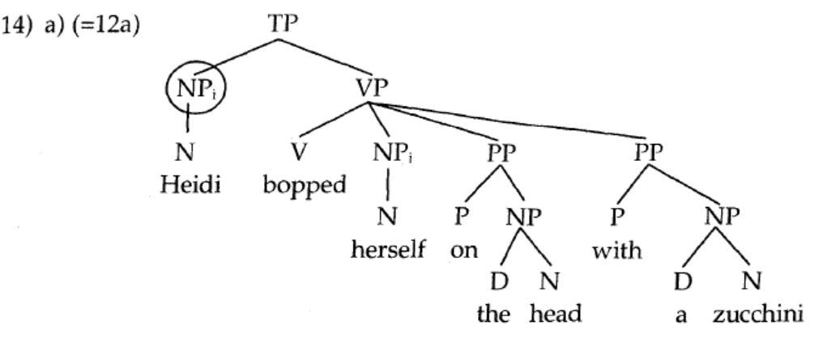
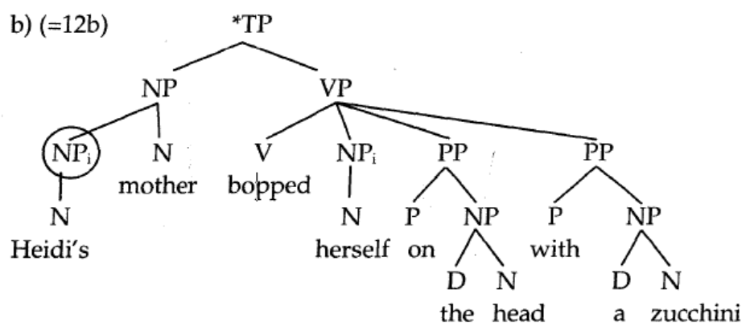
Look at the trees for (12a and b), shown in (14a and b) below, and you will notice a significant difference in terms of the position where the NP immediately dominating Heidi is placed.

Slide 15
In (14a), the circled NP c-commands the NP dominating herself, but in (14b) it does not.
It appears that the crucial relationship between an anaphor and its antecedent involves c-command.
So, in describing the relationship between an anaphor and an antecedent we need a more specific notion than simple co-indexation. This is binding:
15) Binds: A binds B if and only if A c-commands B and A and B are coindexed.

Slide 16
Binding is a special kind of co-indexation.
It is co-indexation that happens when one of the two NPs c-commands the other.
Notice that co-indexation alone does not constitute binding.
Binding requires both co-indexation and c-command.

Slide 17
Now we can make the following generalization, which explains the ungrammaticality of sentences (16a) (=7) and (16b) (=12c):
16) a) (=7) *Herself_{i} bopped Heidi_{i} on the head with a zucchini.
b) (=12c) *[Heidi’s mother]_{i} bopped herself_{i} on the head with a zucchini.
In neither of these sentences is the anaphor bound.
In other words, it is not c-commanded by the NP it is coindexed with.
This generalization is called Binding Principle A.
Principle A determines the distribution of anaphors:

Slide 18
Principle A determines the distribution of anaphors:
17) Binding Principle A (preliminary): An anaphor must be bound.
Remember, bound means coindexed with an NP that c-commands it.
If you look at the tree in (14b) you'll see that the anaphor herself and the NP Heidi are coindexed.
However, they are not bound, since [_{NP} Heidi] does not c-command [_{NP} herself].
The same is true in the tree for (16a) (=7) shown in (18):

Slide 19
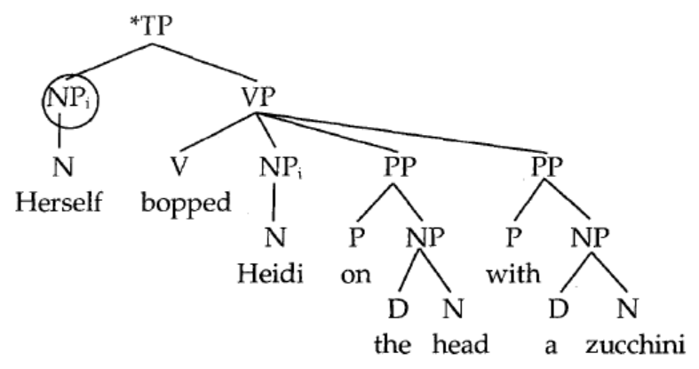
18)
Even though the two NPs are coindexed, they do not form a binding relation, since the antecedent doesn't c-command the anaphor.
You might think that Heidi binds herself, since the anaphor c-commands the antecedent.
But notice that this is not the way binding is defined.
Binding is not a symmetric relationship.
The binder (or antecedent) must do the c-commanding of the bindee (anaphor or pronoun), not the reverse.

Slide 20
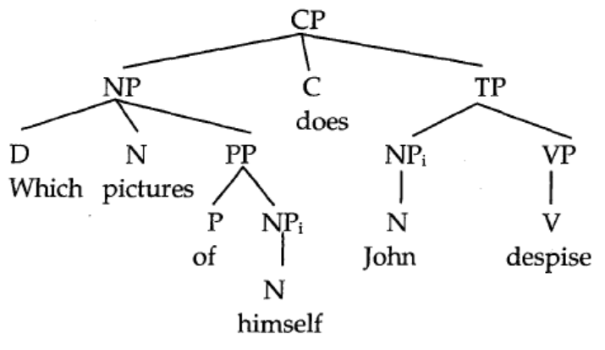
WH-QUESTIONS
Q2. What problem(s) does the following sentence raise for the binding theory as we have
sketched it in this module? Can you think of a solution? (Hint: consider the non-question
form of this sentence John despises these pictures of himself)
Which pictures of himself_{i} does John_{i} despise?
Assume the following tree for this sentence:

Slide 21
3. LOCALITY CONDITIONS ON THE BINDING OF ANAPHORS
Consider now the following fact about anaphors:
19) *Heidi_{i} said that herself_{i} discoed with Art.
(cf. Heidi_{i} said that she_{i} discoed with Art.)

Slide 22
A tree for sentence (19) is given below.
As you can see from this tree, the anaphor is bound by its antecedent: [_{NP}Heidi] c-commands [_{Np}herself] and is coindexed with it.
This sentence is predicted to be grammatical by the version of Principle A presented in (17), since it meets the requirement that anaphors be bound.
Surprisingly, however, the sentence is ungrammatical.

Slide 23
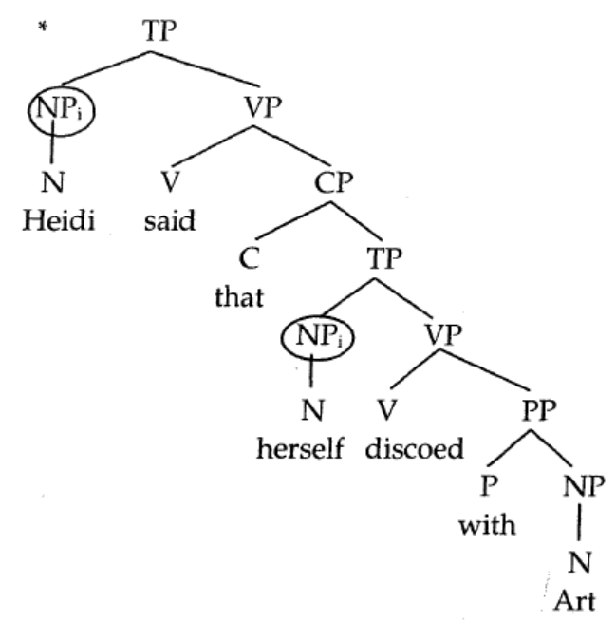
20)
Notice that the difference between a sentence like (19) and a sentence like (12a) is that in the ungrammatical (19) the anaphor is in an embedded clause.
The anaphor seems to need to find its antecedent in the same clause. This is called a locality constraint.
The anaphor's antecedent must be near it or "local" in some way.
The syntactic space in which an anaphor must find its antecedent is called a binding domain.

Slide 24
For the moment let's just assume that the binding domain is the clause (TP).
21) Binding domain: The clause containing the NP (anaphor, pronoun, or R-expression).
With this in mind, let's revise Principle A:
22) Binding Principle A (revised): An anaphor must be bound in its binding domain.

Slide 25
4. THE DISTRIBUTION OF PRONOUNS
Anaphors are not the only NP type with restrictions on their syntactic position.
Pronouns can also be restricted in where they may appear:
23) a) Heidi_{i} bopped her_{j} on the head with the zucchini.
b) *Heidi_{i} bopped her_{i} on the head with the zucchini.
Pronouns like her in the sentences in (23) may not be bound. (They may not be coindexed
by a c-commanding NP.)
The sentence in (23) may only have the meaning where the her refers to someone other than Heidi.

Slide 26
Contrast this situation with the one in which the pronoun is in an embedded clause:
24) a) Heidi_{i} said [_{cp} that she_{i} discoed with Art].
b) Heidi_{i} said [_{cp} that she_{k} discoed with Art].
In this situation, a pronoun may be bound by an antecedent, but it doesn't have to be.
It can be bound, as in (24a), or not bound, as in (24b ).
Unlike the case of anaphors, which must be bound in a particular configuration, pronouns seem only to have a limitation on where they cannot be bound.
That is, a pronoun cannot be bound by an antecedent that is a clause-mate (in the same immediate clause).
You'll notice that this is exactly the opposite of where anaphors are allowed.
This restriction is called Principle B of the binding theory.
It makes use of the term free.
Free is the opposite of bound.

Slide 27
25) Free: Not bound.
26) Principle B: A pronoun must be free in its binding domain.
Given that the binding domain is a clause, the ungrammaticality of (23b) is explained.
Both Heidi and her are in the same clause, so they may not be bound to each other.
The pronoun must be free.
In (24) both indexings are allowed by Principle B.
In (24b) the pronoun isn't bound at all (so is free within its binding domain).
In (24a), the situation is a little trickier: The pronoun is bound, but it isn't bound within its binding domain (the embedded clause). Its binder lies outside the binding domain, so the sentence is grammatical.

Slide 28
5. THE DISTRIBUTION OF R-EXPRESSIONS
R-expressions have yet another distribution.
R-expressions don’t seem to allow any instances of binding at all, not within the binding domain and not outside it either.
27) a) *Heidi_{i} kissed Miriam_{i}.
b) *Art_{i} kissed Geoff_{i}.
c) *She_{i} kissed Heidi_{i}.
d) *She_{i} said that Heidi_{i} was a disco queen.

Slide 29
In none of these sentences can the second NP (all R-expressions) be bound by a c-commanding word.
This in and of itself isn't terribly surprising, given the fact that R expressions receive their meaning from outside the sentence (i.e., from the context).
That they don't get their meaning from another word in the sentence (via binding) is entirely expected.
We do have to rule out situations like (27), however.
The constraint that describes the distribution of R-expressions is called Principle C.
28) Principle C: An R-expression must be free.
Notice that Principle C says nothing about a binding domain.
Essentially R-expressions must be free everywhere.
They cannot be bound at all.

Slide 30
Exercise for BINDING PRINCIPLES
Q. Explain why the following sentences are ungrammatical. For each sentence, say what the binding
domain of the NP causing the problem is, whether it is c-commanded by its binder (antecedent), and
name the binding condition that is violated.
a) *Michael_{i} loves him_{i}.
b) *Hei loves Michael_{i}.
c) *Michael_{i}’s father_{j} loves himsel_{i}.
d) *Michael_{i}’s father_{j} loves himj.
e) *Susan_{i} thinks that John should invite herself_{i}.
f) *Susan thinks that John_{i} should kiss him_{i}.

Slide 31
7. CONCLUSION
We looked at a very complex set of data concerning the distribution of different kinds of NPs.
We saw that these different kinds of NPs can appear in different syntactic positions.
A simple set of binding principles (A, B, and C) governs the distribution of NPs.

Slide 32
Summing up the Binding Theory
Three types of NPs
English distinguish three types of NPs by (mostly) morphosyntactic criteria.
These are illustrated in (1.8a–1.8c):
(1) (a) Reflexives and Reciprocals (‘anaphors’):
Reflexives = himself, herself, itself, themselves, myself, yourself, ourselves, yourselves
Reciprocals = each other, one another
(b) non-reflexive pronouns (‘pronominals’):
he, she, it, him, her, I, us, you, me, his, your, my, our
(c) full NPs including names (‘R-expressions’):
Peter, John, Mary, Mango, Cat, Table, etc.

Slide 33
Table 1.1 Distribution of the three NP-types
configuration ex Reflexive Pronouns R-expression (full NP)
If no antecedent (1) ∗ ok ok
If non-local antecedent (2) ∗ ok ∗
If local antecedent (3) ok ∗ ∗
(1.) (a) That it rains bothers Peter.
(b) That it rains bothers her / him.
(c) ∗That it rains bothers himself / herself.
(2) (a) ∗Carla_{i} thinks that I hate Carla_{i}.
(b) Carla_{i} thinks that I hate her_{i}.
(c) ∗Carla_{i} thinks that I hate herself_{i}.
(3) (a) ∗Peter_{i} watches Peter_{i} in the mirror.
(b) ∗Peter_{i} watches him_{i} in the mirror.
(c) Peter_{i} watches himself_{i} in the mirror.

Slide 34
Reflexives – need local antecedent
Pronouns – may not need an antecedent
R-expression – are free every where

Slide 35
Reflexive and pronouns
Reflexive pronouns require an antecedent, and an antecedent must be within their local clause.
(1) (a) ∗That it rains bothers himself / herself. (no antecedent)
(b) ∗Carla_{i} thinks that I hate herself_{i}. (non-local antecedent)
(c) Peter_{i} watches himself_{i} in the mirror. (local antecedent)

Slide 36
Pronouns can occur with or without a sentence-internal antecedent, as long as the antecedent is not in the same local clause,
(2) (a) That it rains bothers him/her. (no antecedent)
(b) Carla_{i} thinks that I hate her_{i}. (non-local antecedent)
(c) ∗Peter_{i} watches him_{i} in the mirror. (local antecedent)

Slide 37
Binding Conditions:
Binding Conditions
A reflexive pronoun must have an antecedent within its local clause.
(1) Carla saw herself in the mirror. (here herself has local antecedent. So, grammatical)
(2) ∗Carla’s dog accompanies herself to kindergarten. (here herself has non-local antecedent.
So, ungrammatical)
(B) A pronoun must not have an antecedent within its local clause, it may have outside the local clause.
(1) I saw her. (here her does not have antecedent)
(2) Carla_{i}’s dog accompanies her_{i} to kindergarten. (here her has antecedent but non-local antecedent)
(3) * She_{i} saw her_{i} (here her has local antecedent therefore WRONG)
(4) She_{i} saw her_{j} (here her and she are different persons.
So, grammatical)

Slide 38
Basic terms summary
i) R-expression: An NP that gets its meaning by referring to an entity in the world.
ii) Anaphor: An NP that obligatorily gets its meaning from another NP in the sentence.
iii) Pronoun: An NP that may (but need not) get its meaning from another NP in the sentence.
iv) Antecedent: The element that binds a pronoun, anaphor orR-expression. When this element c-
commands another coindexed NP, it is a binder of that NP.
v) Index: A subscript mark that indicates what an NP refers to.
vi) Coindexed: Two NPs that have the same index are said to be coindexed.
vii) Corefer: Two NPs that are coindexed are said to corefer (refer to the same entity in the world).

Slide 39
viii) Binding: A binds B if and only if A c-commands B and A and B are coindexed.
A is the binder, B is the bindee.
ix) Locality Constraint: A constraint on the grammar, such that two syntactic entities must be ulocal" or
near to one another.
x) Binding Domain: The clause containing the NP. (for our purposes).
xi) Free: Not bound.
xii) The Binding Principles
Principle A: An anaphor must be bound in its binding don1ain.
Principle B: A pronoun must be free in its binding domain.
Principle C: An R-expression must be free.

Slide 40
Reference
Carnie, A. (2021). Syntax: A Generative Introduction (Fourth Edition). Wiley Blackwell.

